Slide 1
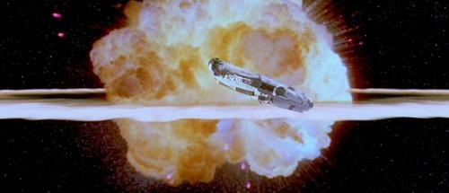
Challenger Space Shuttle Disaster

Slide 2
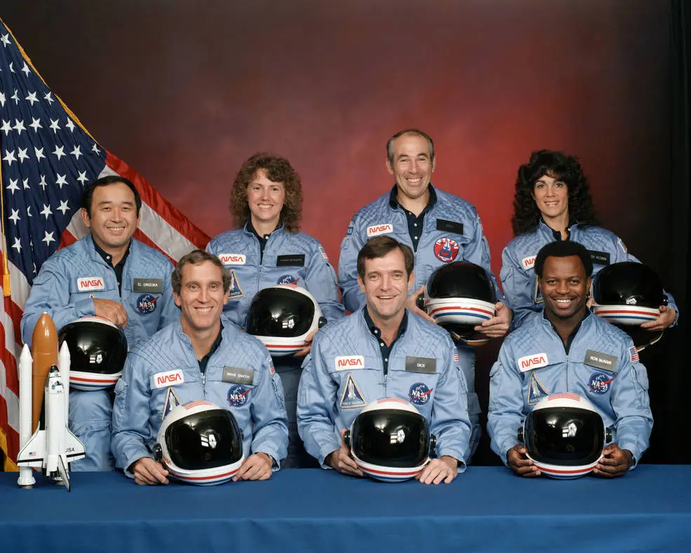
Context
10th flight of orbiter and 25th flight of Space Shuttle fleet
Challenger mission goals:
deploy communications satellite
study Halley’s Comet
give a lesson from space
The flight was highly publicized due to the Teacher in Space program, which aimed to send an ordinary person to space
The flight took place on January 28, 1986 after a weather delay
Exploded 73 seconds into its flight off the coast of Florida
The flight was watched live by many schools and remains an infamous moment for those who grew up in the 1980s
Teacher

Slide 3
The Launch
Air temperatures record low for Space Shuttle Launch (-3 ℃ at time of launch)
11:38 a.m. Launched from Kennedy Space Center Launch Complex 39B
T+37: Wind shear conditions starting
T+58.788: beginnings of plume near aft attach strut
T+64.660: leak in liquid hydrogen tank
T+66.764: pressure in liquid hydrogen tank started to drop
T+68: throttled up to 104% thrust
T+72.284: solid rocket booster detaching from aft strut producing lateral acceleration
T+73.044: Sharp decrease of liquid hydrogen pressure in main engine
T+73.124: white vapor seen evacuating from the craft
T+74.587: Explosion visible from ground

Slide 4
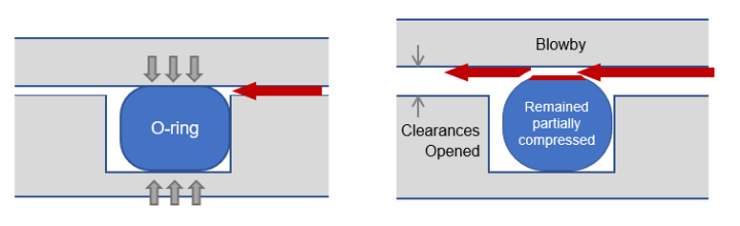
Technical Factors
O-rings contracted due to extreme cold on the morning of the launch
O-ring resiliency had issues when used below 10°C
Defect was not revealed due to inadequate testing in extreme conditions
Loss of seal caused fuel to mix improperly, leak, and cause an explosion
Lack of redundancy; if one joint broke the whole system had catastrophic failure

Slide 5
Human and Organizational Factors
Contracted out to private contractors to build their systems to save time.
Lack of coherent communication
Communication and reporting failures
NASA engineers suggested field joints to be redesigned to include shims around the O-rings
No response was received
After further requests for O-ring testing, NASA program managers decided that current testing levels were sufficient
Concerns on O-rings not performing to the temperature of the launch day
NASA did not have accountability built in due to past successes
We’re NASA, what could possibly go wrong?
Production pressures and scheduling demands
Temperatures on the launch date were record-lows for space shuttle launches and it had been shown that O-ring erosion had occurred at higher temperatures already.
The VP of Engineering and VP of Space Booster Programs recommended against the launch.
A conference was held and pressured management to change their opinion based on “inconclusive evidence”

Slide 6
Main Takeaways
NASA established Office of Safety, Reliability, and Quality Assurance
New shuttle advisory commission and new checkpoints before launch
Teacher in Space Program discontinued in 1990
Listen to warnings, no investigation is unnecessary if it can save lives
Safety first
Technical issues could have been prevented if human factors (rushing, accepting not quite sufficient test data) had been addressed properly

